Slide 1
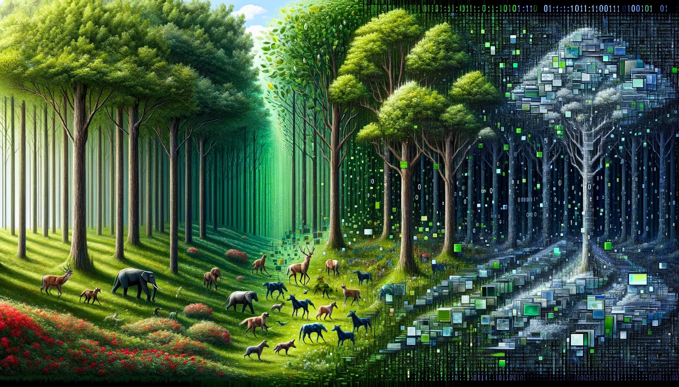
Machine Learning Basics: Landslide Edition
-Neel Kasmalkar

Slide 2



What is machine learning?
Computer looks for patterns in the data.
It learns the patterns.
It then uses its learning to predict.
data
pattern
prediction

Slide 3
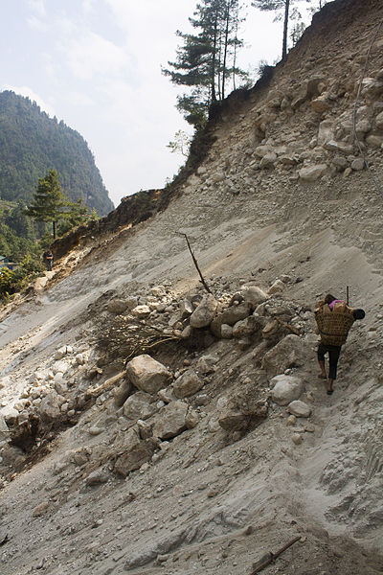
Landslides: a classification problem
If we know certain characteristics, can we predict landslide susceptibility?
Terrain: slope, elevation
Soil: clay %, sand %
Meteorology: rainfall
Land characteristics
Machine learning
Landslide: YES/NO?
Nicklassletteland: Landslide on Trail Near Phakding.

Slide 4
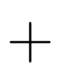
Logistic Regression: put a curve through the data
c
p: probability of landslide
Curvature
Elevation
Slope
Probability of landslide
=
Weighted sum of input variables

Slide 5
Logistic Regression: put a curve through the data
Output
Machine-learnt
Input
c
p: probability of landslide
Curvature
Elevation
Slope
Probability of landslide
=
Weighted sum of input variables

Slide 6

Training vs Testing
Training data: for teaching the model
Full data
Test data: for evaluating the model
Keep test data separate to ensure model is not cheating (i.e. overfitting).

Slide 7
(Toy example)
Confusion Matrix
Predicted Observed | False | True
False | 90 | 5
True | 2 | 3
Accuracy: how many answers does the model get right?
Precision: among the answers predicted by model as true, how many are actually true?
Recall: Among all the true answers, how many does model get right?

Slide 8
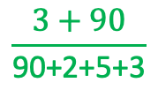
(Toy example)
Confusion Matrix
Predicted Observed | False | True
False | 90 | 5
True | 2 | 3
$$\frac{3+90}{\text{90+2+5+3}}$$
Accuracy: how many answers does the model get right?
Precision: among the answers predicted by model as true, how many are actually true?
Recall: Among all the true answers, how many does model get right?

Slide 9
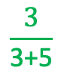
(Toy example)
Confusion Matrix
Predicted Observed | False | True
False | 90 | 5
True | 2 | 3
$$\frac{3+90}{\text{90+2+5+3}}$$
Accuracy: how many answers does the model get right?
Precision: among the answers predicted by model as true, how many are actually true?
Recall: Among all the true answers, how many does model get right?
$$\frac{3}{\text{3+5}}$$

Slide 10
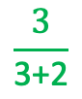
(Toy example)
Confusion Matrix
Predicted Observed | False | True
False | 90 | 5
True | 2 | 3
$$\frac{3+90}{\text{90+2+5+3}}$$
Accuracy: how many answers does the model get right?
Precision: among the answers predicted by model as true, how many are actually true?
Recall: Among all the true answers, how many does model get right?
$$\frac{3}{\text{3+5}}$$
$$\frac{3}{\text{3+2}}$$

Slide 11
Is having more data better?
More data points is generally good. But new data must have something different in it from the old data.
More variables means more complexity. Machine might accidentally find patterns where none exist.

Slide 12
Logistic Regression is too structured
Landslide probability
Logistic regression can only produce these shapes.
Curvature
Curvature
What if the real pattern is this?
Landslide probability
Curvature

Slide 13
Decision trees
Example decisions
If …
If slope > 45
If elevation < 1000
If …
If …
If curvature > 0.2
If …
If …
If …
If …
landslide
No landslide
No landslide
landslide
Computer can generate decision trees to best separate landslide and no landslide

Slide 14
Random Forest: wisdom of the trees
Random forest = collection of decision trees
Each tree randomly gets different subsets of data and features.
Final output by popular vote (classification) or mean (regression).

Slide 15
Random Forest: wisdom of the trees
Random forest = collection of decision trees
Each tree randomly gets different subsets of data and features.
Final output by popular vote (classification), or mean (regression).
n | elev | cprof | slope | area
1
2
3
4
5
6
7
8
9
Data distribution:
Decision tree 1
Decision tree 2
Decision tree 3
.
.
.

Slide 16
Random Forest: wisdom of the trees
Random forest = collection of decision trees
Each tree randomly gets different subsets of data and features.
Final output by popular vote (classification), or mean (regression).
n | elev | cprof | slope | area
1
2
3
4
5
6
7
8
9
Data distribution:
Decision tree 1
Decision tree 2
Decision tree 3
.
.
.
If …
If …
If …
If …
If …
If …
If …

Slide 17
Random Forest: wisdom of the trees
Random forest = collection of decision trees
Each tree randomly gets different subsets of data and features.
Final output by popular vote (classification), or mean (regression).
n | elev | cprof | slope | area
1
2
3
4
5
6
7
8
9
Data distribution:
Decision tree 1
Decision tree 2
Decision tree 3
.
.
.
If …
If …
If …
If …
If …
If …
If …
If …
If …
If …
If …
If …

Slide 18
Random Forest: wisdom of the trees
Random forest = collection of decision trees
Each tree randomly gets different subsets of data and features.
Final output by popular vote (classification), or mean (regression).
n | elev | cprof | slope | area
1
2
3
4
5
6
7
8
9
Data distribution:
Decision tree 1
Decision tree 2
Decision tree 3
.
.
.
If …
If …
If …
If …
If …
If …
If …
If …
If …
If …
If …
If …
If …
If …
If …
If …
If …
If …
If …
Popular vote

Slide 19
Random Forest hyperparameters
1. Number of trees (ntree)
More trees = more stable prediction. But more computation.
2. Maximum depth (max.depth)
More depth = more decision branching = capture more complexity.
But can lead to overfitting.

Slide 20
Take-off point
Random forests are one of the best machine learning models out there.
Be careful about overfitting.
Think about where you can use random forests. The code is there. You just need to prepare the dataset for your problem.

